Slide 1
Scene Understanding with Deep Structured Models
Anurag Arnab

Slide 2
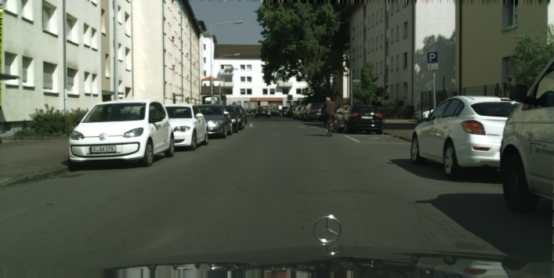
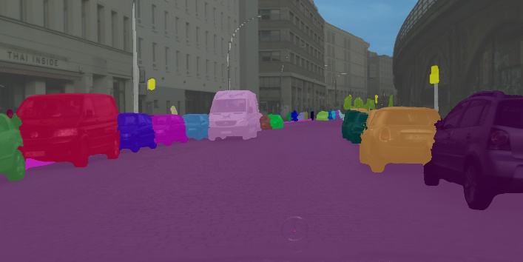
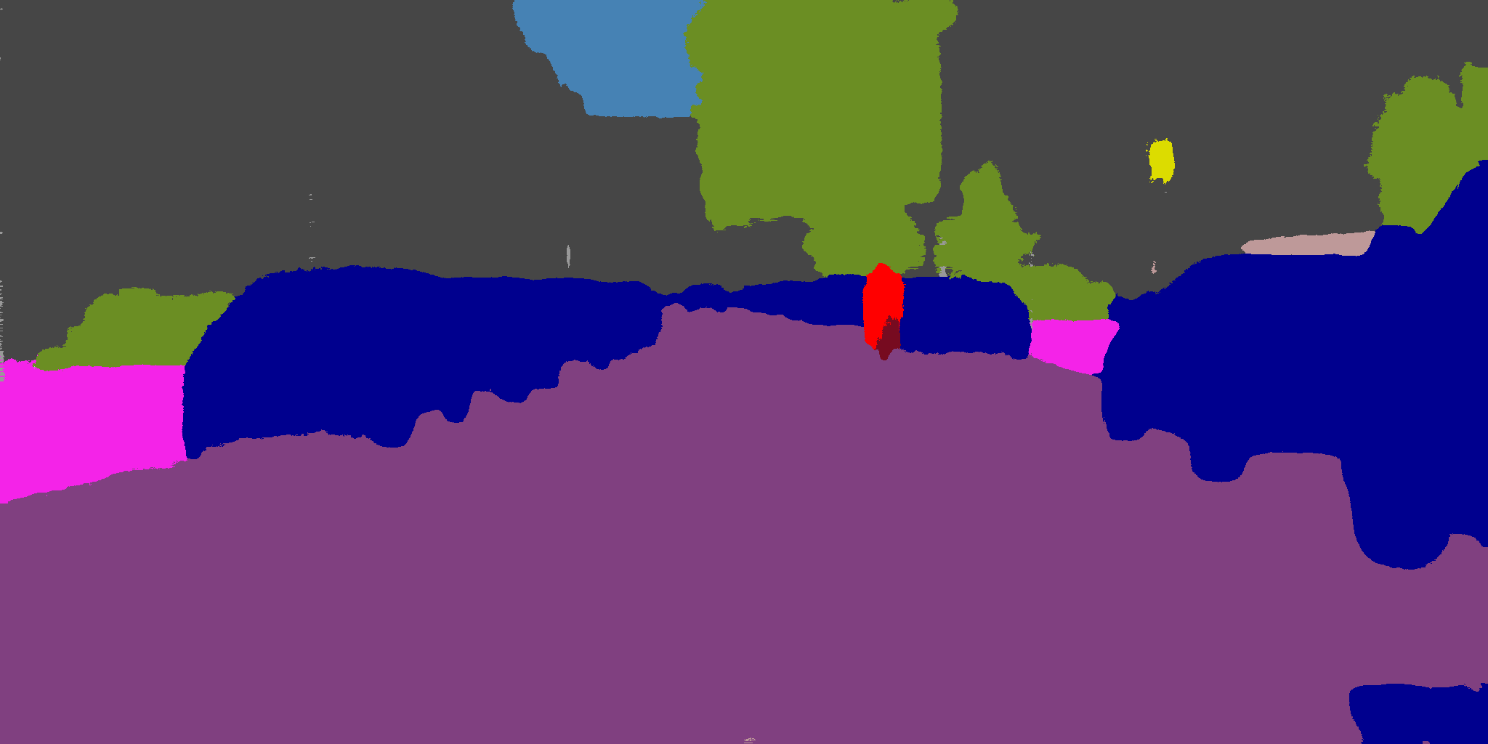
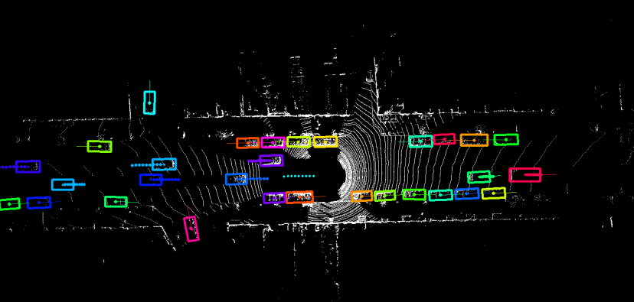
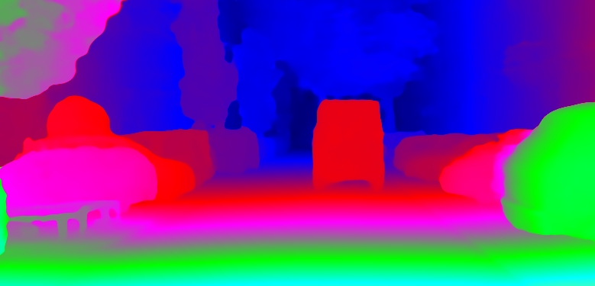
Scene Understanding
Semantic segmentation
Instance/Panoptic segmentation
Pose estimation
Optical flow
3D object detection
Stereo
Object detection

Slide 3
Scene Understanding
Semantic segmentation
Instance/Panoptic segmentation

Slide 4
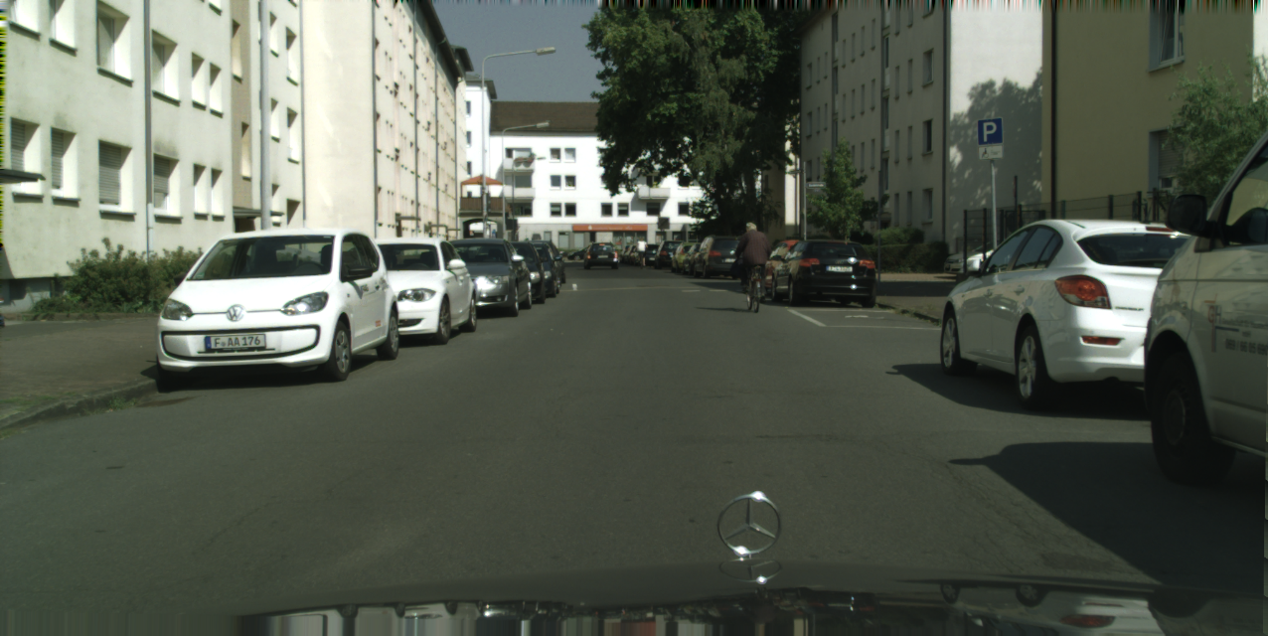
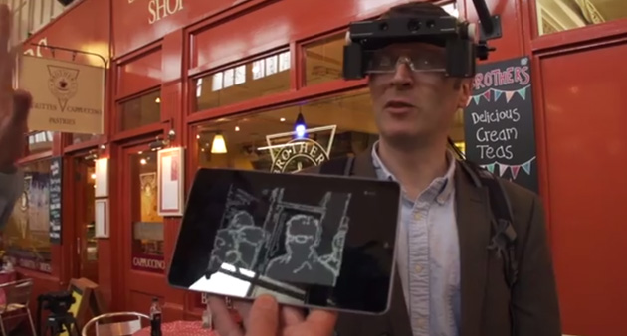
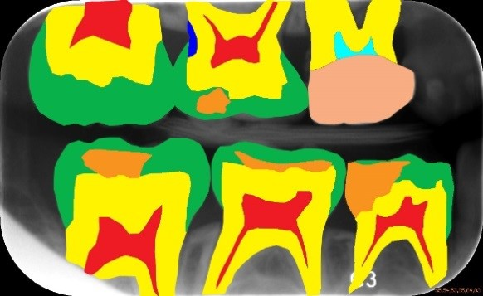
Why Pixel-level Scene Understanding
Autonomous navigation
Assisting the partially sighted
AR / VR
Medical diagnosis
Image editing
Many more …

Slide 5
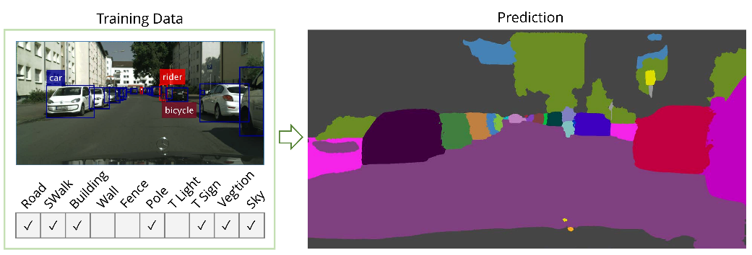
Outline
Higher Order CRFs in Deep Neural Networks (ECCV 2016)
Pixelwise Instance Segmentation with a Dynamically Instantiated Network (CVPR 2017)
Weakly and Semi-Supervised Panoptic Segmentation (ECCV 2018)

Slide 6
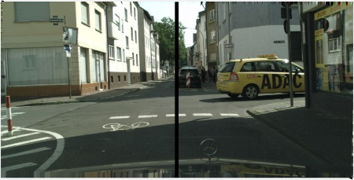
Outline
Exploiting Temporal Context for 3D Pose Estimation in the Wild (CVPR 2019) – DeepMind internship
On the Robustness of Semantic Segmentation Models to Adversarial Attacks (CVPR 2018)

Slide 7
Outline
Higher Order CRFs in Deep Neural Networks (ECCV 2016)
Pixelwise Instance Segmentation with a Dynamically Instantiated Network (CVPR 2017)
Weakly and Semi-Supervised Panoptic Segmentation (ECCV 2018)

Slide 8
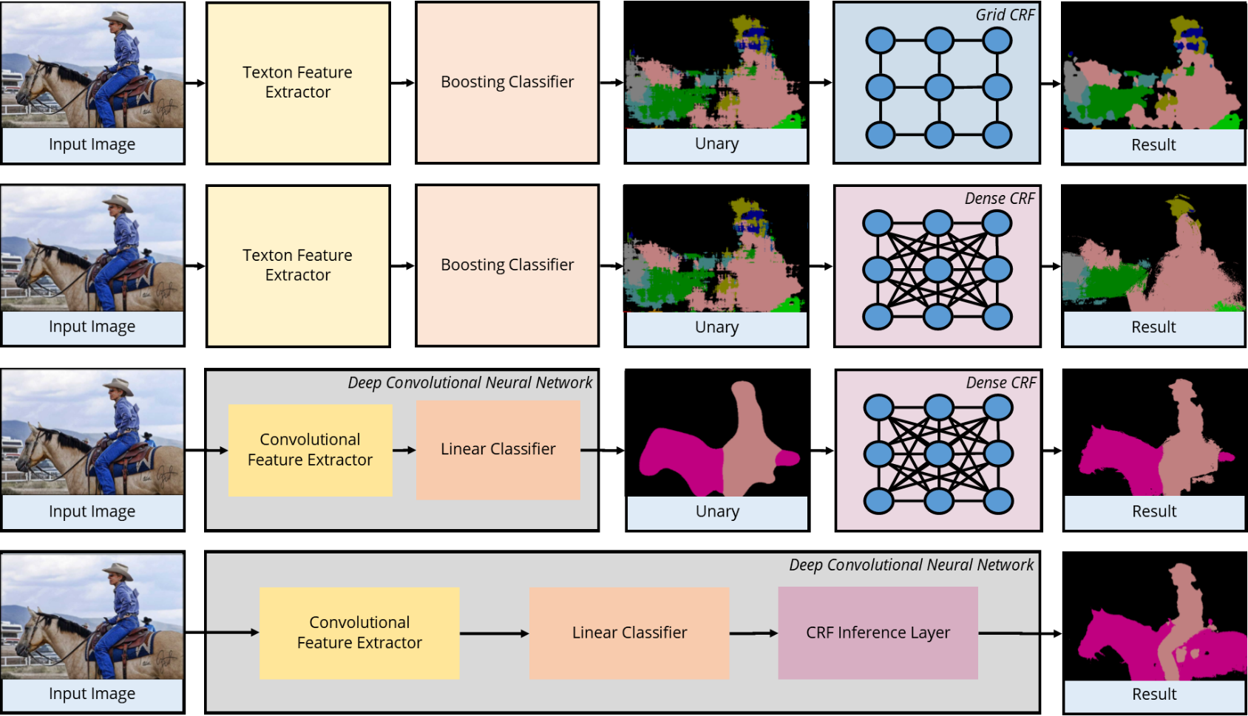
Structured Prediction
Structured prediction (predicting many correlated variables – ie pixels)
Ladicky et al. ICCV 2009
Krahenbuhl and Koltun NIPS 2011
Chen et al. ICLR 2015
Arnab et al. ECCV 2016
Ladicky et al. ICCV 2009. Krahenbuhl and Koltun. NIPS 2011. Chen et al. ICLR 2015. Arnab et al. ECCV 2016.

Slide 9
Structured Prediction
Structured prediction (predicting many correlated variables – ie pixels)
Ladicky et al. ICCV 2009
Krahenbuhl and Koltun NIPS 2011
Chen et al. ICLR 2015
Arnab et al. ECCV 2016
Ladicky et al. ICCV 2009. Krahenbuhl and Koltun. NIPS 2011. Chen et al. ICLR 2015. Arnab et al. ECCV 2016.

Slide 10
Structured Prediction
Structured prediction (predicting many correlated variables – ie pixels)
Ladicky et al. ICCV 2009
Krahenbuhl and Koltun NIPS 2011
Chen et al. ICLR 2015
Arnab et al. ECCV 2016
Ladicky et al. ICCV 2009. Krahenbuhl and Koltun. NIPS 2011. Chen et al. ICLR 2015. Arnab et al. ECCV 2016.

Slide 11
Structured Prediction
Structured prediction (predicting many correlated variables – ie pixels)
Ladicky et al. ICCV 2009
Krahenbuhl and Koltun NIPS 2011
Chen et al. ICLR 2015
Arnab et al. ECCV 2016
Zheng et al. ICCV 2015. Schwing and Urtasun. arXiv 2015.

Slide 12
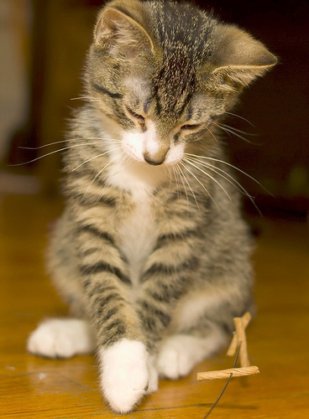
Conditional Random Fields
$X_{1}∈$ {bg, cat, car, person, …}
$X_{1}=$ bg
$X_{4}=$ cat
Define a discrete random variable, $X_{i},$for each pixel $i$
Each $X_{i}$ takes a value from the label set $ℒ$
The random variables are connected to form a random field. The most probable assignment, conditioned on the image, is our semantic segmentation result.

Slide 13
The Best Assignment
$P\left(X_{1}=x_{1}, X_{2}=x_{2}, …, X_{N}=x_{n}\right)=P\left(X=x \right|I)$
$P\left(X=x \right|I)=\frac{1}{Z} exp{(−E\left(x \right|I)}$
Maximising the probability, is equivalent to minimising the energy of the CRF.
$$X_{i}= l_{1}$$

Slide 14
Energies
Unary
Your final label does not agree with the initial classifier
→ you pay a penalty
In our case, the initial classifier is FCN [1]
Pairwise
Detection
Superpixels
$$X_{i}= l_{1}$$
[1] Long et al. CVPR 2015

Slide 15
Energies
Unary
Pairwise
You assign different labels to two very similar pixels
→ you pay a penalty
How do you measure similarity?
DenseCRF [1]
$Ψ_{i,j}^{P}\left(x_{i} , x_{j}\right)=w_{1}exp\left(−\frac{| p_{i} −p_{j}|^{2}}{2σ_{α}^{2}}−\frac{| I_{i} −I_{j}|^{2}}{2σ_{β}^{2}} \right)+w_{2}exp\left(−\frac{| p_{i} −p_{j}|^{2}}{2σ_{γ}^{2}} \right)$
Detection
Superpixels
$$X_{i}$$
$$X_{j}$$
[1] Krahenbuhl and Koltun, NIPS, 2011

Slide 16
Energies
Unary
Pairwise
Detection (Higher order)
Inference with pairwise potentials cannot help if unaries are poor
Cues from object detectors can help in this regard
Object detectors can “fire” over regions which have poor/incorrect unaries
Want our potential to be robust to false-positive detections
Introduce additional latent, $Y$ variables which model whether the detection hypothesis is accepted or not
$ψ_{d}^{Det}\left(X_{d}=x_{d}, Y_{d}=y_{d}\right)= \left\{\begin{aligned}w_{det}\frac{s_{d}}{n_{d}} \sum_{i=1}^{n_{d}}{\left[x_{d}^{\left(i\right)}=l_{d}\right] ify_{d}=0} \\ w_{det}\frac{s_{d}}{n_{d}} \sum_{i=1}^{n_{d}}{\left[x_{d}^{\left(i\right)}≠l_{d}\right] ify_{d}=1}\end{aligned}\right.$
Superpixels
$$Y_{1}$$

Slide 17
Energies
Unary
Pairwise
Detections
Superpixels
Enforce consistency over entire regions obtained by superpixels
$P^{n}$-Potts model type energy [1,2]
Low cost if all the random variables within a superpixel are assigned the same label. High cost otherwise
Reduces spurious noise in segmentations
$ψ_{s}^{SP}\left(X_{s}=x_{s}\right)= \left\{\begin{aligned}w_{low}\left(l\right) \text{if} \text{all} x_{s}^{(i)}=l \\ w_{high} \text{otherwise} \end{aligned}\right.$
Each colour represents a different superpixel
[1] Kohli et al. CVPR 2007. [2] Ladicky et al. ICCV 2009

Slide 18
Inference
We have an energy that we want to minimise.
Minimum energy is the highest probability
$E\left(x\right)= \sum_{i}{ψ_{i}^{U}(x_{i})}+\sum_{i<j}{ψ_{i,j}^{P}(x_{i}, x_{j})}+\sum_{d}{ψ_{d}^{Det}\left(x_{d}\right)+\sum_{s}{ψ_{s}^{SP}(x_{s}})}$
During the forward pass of our network, we want to implement this energy minimisation / MAP estimation procedure
Unaries from CNN
Pairwise [1]
Detection potentials
Superpixel potentials
[1] Krahenbuhl and Koltun, NIPS, 2011

Slide 19
Mean Field Inference
Our labelling is the most-likely assignment
$\arg{\max_{x}{P⁡(X=x|I)}}$
Approximate real distribution, $P$, with simpler one $Q$
$Q\left(X\right)=\prod_{i}{Q_{i}(X_{i})}$
Minimise KL-Divergence between $Q$ and $P$
$KL(Q|\left|P\right)=−\sum_{x∈𝓍}{Q\left(x\right) \log{(Q(x))}+Q\left(x\right) \log{(P(x))}}$

Slide 20
Higher Order CRFs in Deep Neural Nets
Mean-field: common inference algorithm for the MAP (maximum a posteriori) estimate of a CRF.
Iterative inference algorithm that is also differentiable
Initialise
$$Q_{i}=\frac{1}{Z_{i}}\exp\left(U_{i}(l)\right)$$
while not converged do
$$Q^{t+1}\left(V_{i}=l\right)=\frac{1}{Z_{i}}\exp\left(−\sum_{c∈C}{\sum_{{\{v}_{c} \left| v_{i}=l\right\}}{Q^{t}(v_{c−i}}})ψ(v_{c} ;θ)\right)$$
end

Slide 21
Higher Order CRFs in Deep Neural Nets
Mean-field: Iterative inference algorithm that is also differentiable
We can formulate it as a recurrent neural network and optimise our network end-to-end
Initialise
$$Q_{i}=\frac{1}{Z_{i}}\exp\left(U_{i}(l)\right)$$
while not converged do
$$Q^{t+1}\left(V_{i}=l\right)=\frac{1}{Z_{i}}\exp\left(−\sum_{c∈C}{\sum_{{\{v}_{c} \left| v_{i}=l\right\}}{Q^{t}(v_{c−i}}})ψ(v_{c} ;θ)\right)$$
end
$$Q^{T}=\text{update}\left(… \text{update}\left(\text{update}\left(\text{update}\left(Q^{1}\right)\right)\right) …\right)$$

Slide 22
Higher Order CRFs in Deep Neural Nets
Mean-field: Iterative inference algorithm that is also differentiable
We can formulate it as a recurrent neural network and optimise our network end-to-end
Initialise
$$Q_{i}=\frac{1}{Z_{i}}\exp\left(U_{i}(l)\right)$$
for t = 1 … T
$$Q^{t+1}\left(V_{i}=l\right)=\frac{1}{Z_{i}}\exp\left(−\sum_{c∈C}{\sum_{{\{v}_{c} \left| v_{i}=l\right\}}{Q^{t}(v_{c−i}}})ψ(v_{c} ;θ)\right)$$
end

Slide 23
Results
On PASCAL VOC 2012 reduced validation set
Method | Mean IoU [%]
Unary - FCN [1] | 68.3
Pairwise [2] | 72.9
Pairwise + Superpixels | 74.0
Pairwise + Detections | 74.9
Pairwise + Superpixels + Detections | 75.8
[1] Long et al. CVPR 2015. [2] Zheng, Jayasumana et al. ICCV 2015

Slide 24
Results
On PASCAL VOC 2012 reduced validation set
Method | Mean IoU [%] Not end-to-end | Mean IoU[%] end-to-end trained
Unary - FCN [1] | 68.3
Pairwise [2] | 69.5 | 72.9
Pairwise + Superpixels + Detections | 73.6 | 75.8
[1] Long et al. CVPR 2015. [2] Zheng, Jayasumana et al. ICCV 2015

Slide 25
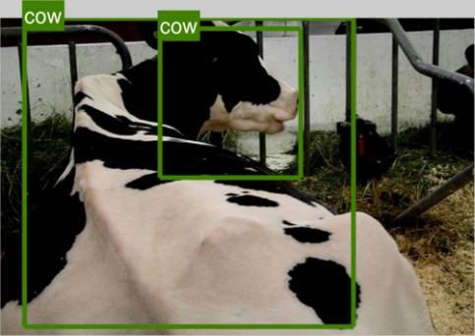
Results
FCN
$$E\left(x\right)= \sum_{i}{ψ_{i}^{U}(x_{i})}$$

Slide 26
Results
Pairwise
$$E\left(x\right)= \sum_{i}{ψ_{i}^{U}(x_{i})}+\sum_{i<j}{ψ_{i,j}^{P}(x_{i}, x_{j})}$$
FCN

Slide 27
Results
Superpixels
$$E\left(x\right)= \sum_{i}{ψ_{i}^{U}(x_{i})}+\sum_{i<j}{ψ_{i,j}^{P}(x_{i}, x_{j})}+\sum_{s}{ψ_{s}^{SP}(x_{s}})$$
FCN
Pairwise

Slide 28
Results
Detections
$$E\left(x\right)= \sum_{i}{ψ_{i}^{U}(x_{i})}+\sum_{i<j}{ψ_{i,j}^{P}(x_{i}, x_{j})}+\sum_{d}{ψ_{d}^{Det}(x_{d}, y_{d}})$$
FCN
Pairwise
Superpixels

Slide 29
Results
$$E\left(x\right)= \sum_{i}{ψ_{i}^{U}(x_{i})}+\sum_{i<j}{ψ_{i,j}^{P}(x_{i}, x_{j})}+\sum_{s}{ψ_{s}^{SP}(x_{s})}+ \sum_{d}{ψ_{d}^{Det}(x_{d}, y_{d}})$$
FCN
Pairwise
Superpixels
Detections
All

Slide 30
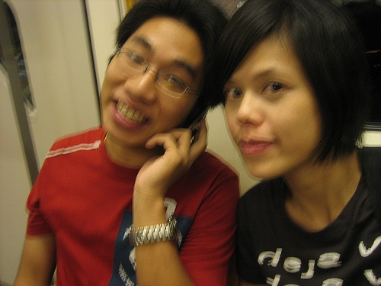
Error Analysis
Input image
Ground truth
Interior
Boundary

Slide 31
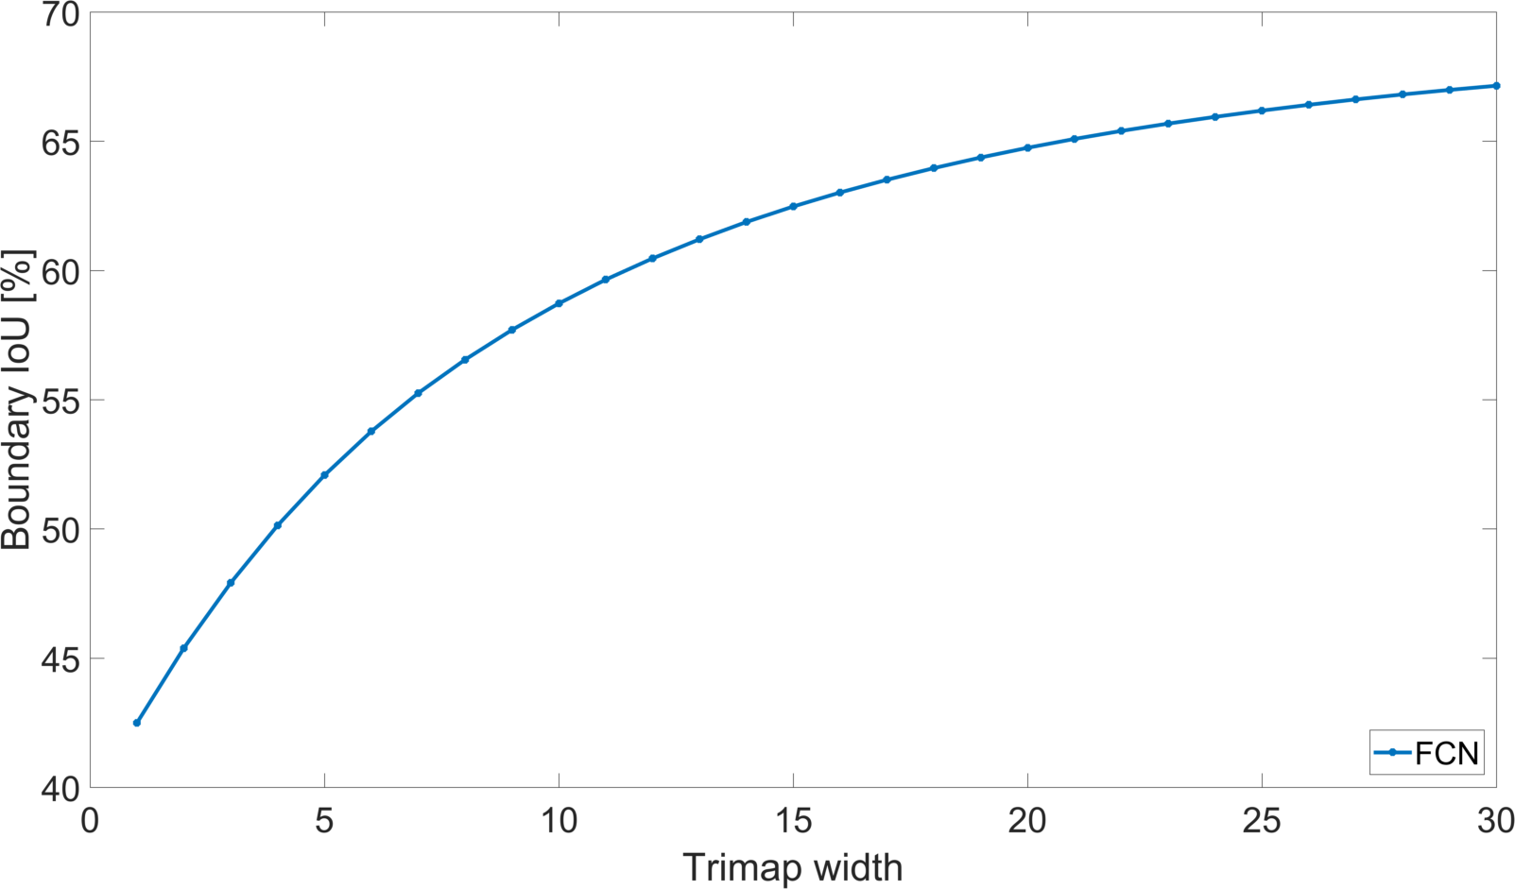
Error Analysis
Input image
Ground truth
Interior
Boundary

Slide 32
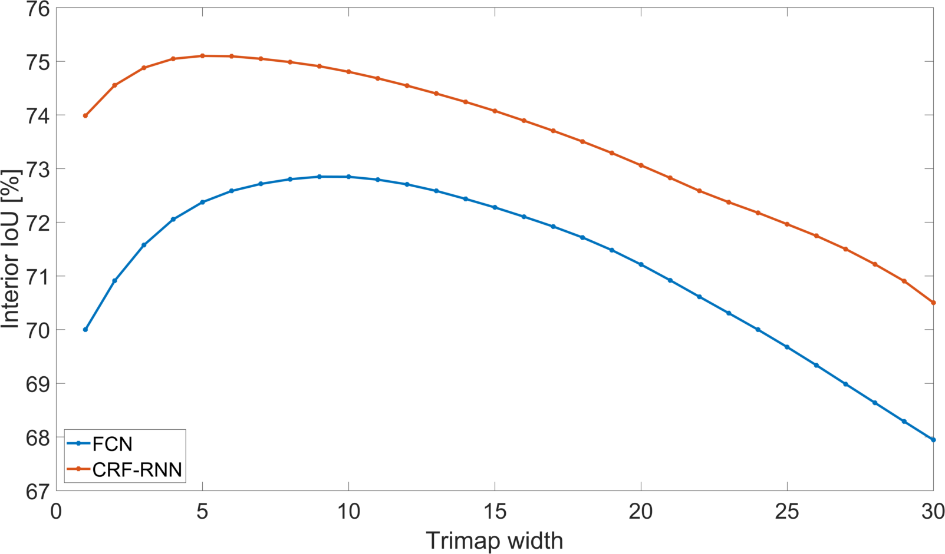
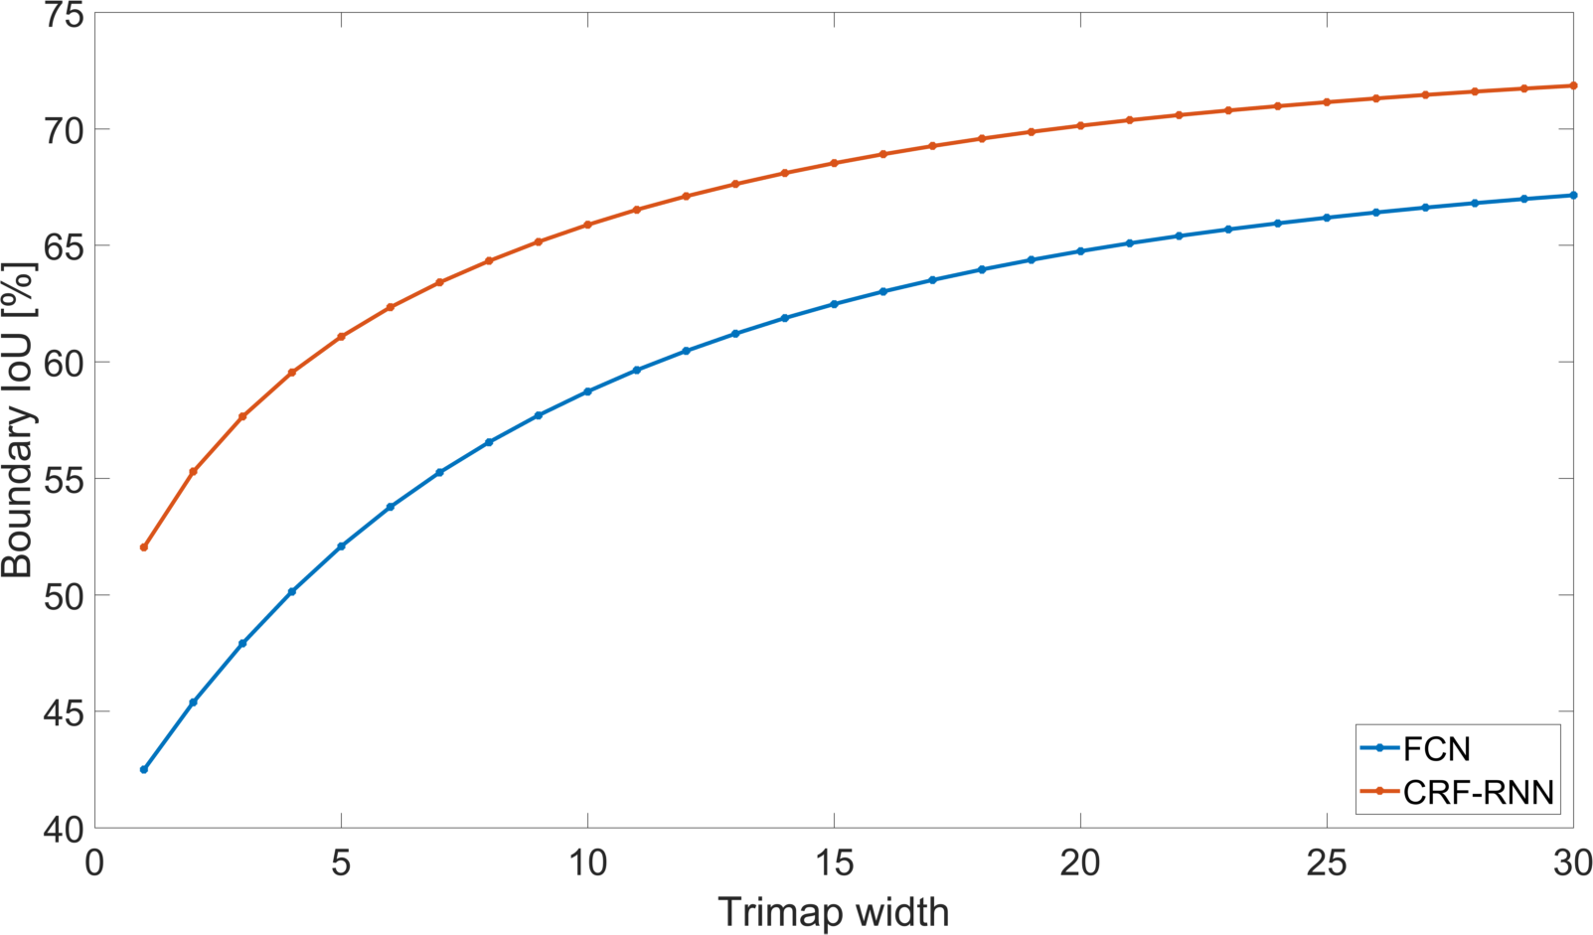
Error Analysis
Input image
Ground truth
Interior
Boundary

Slide 33
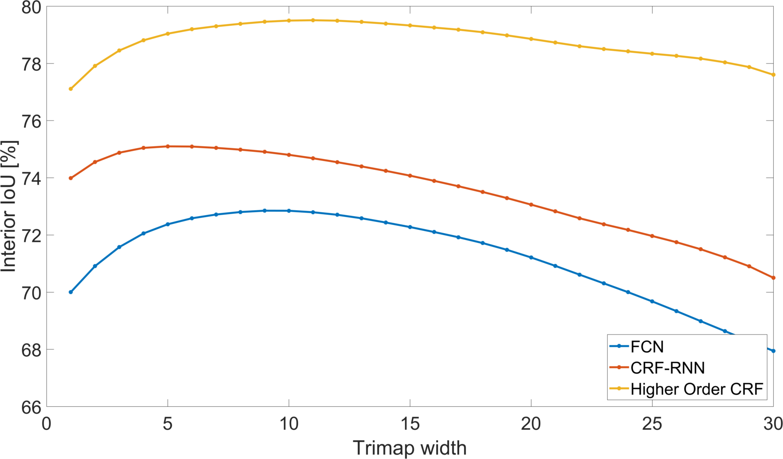
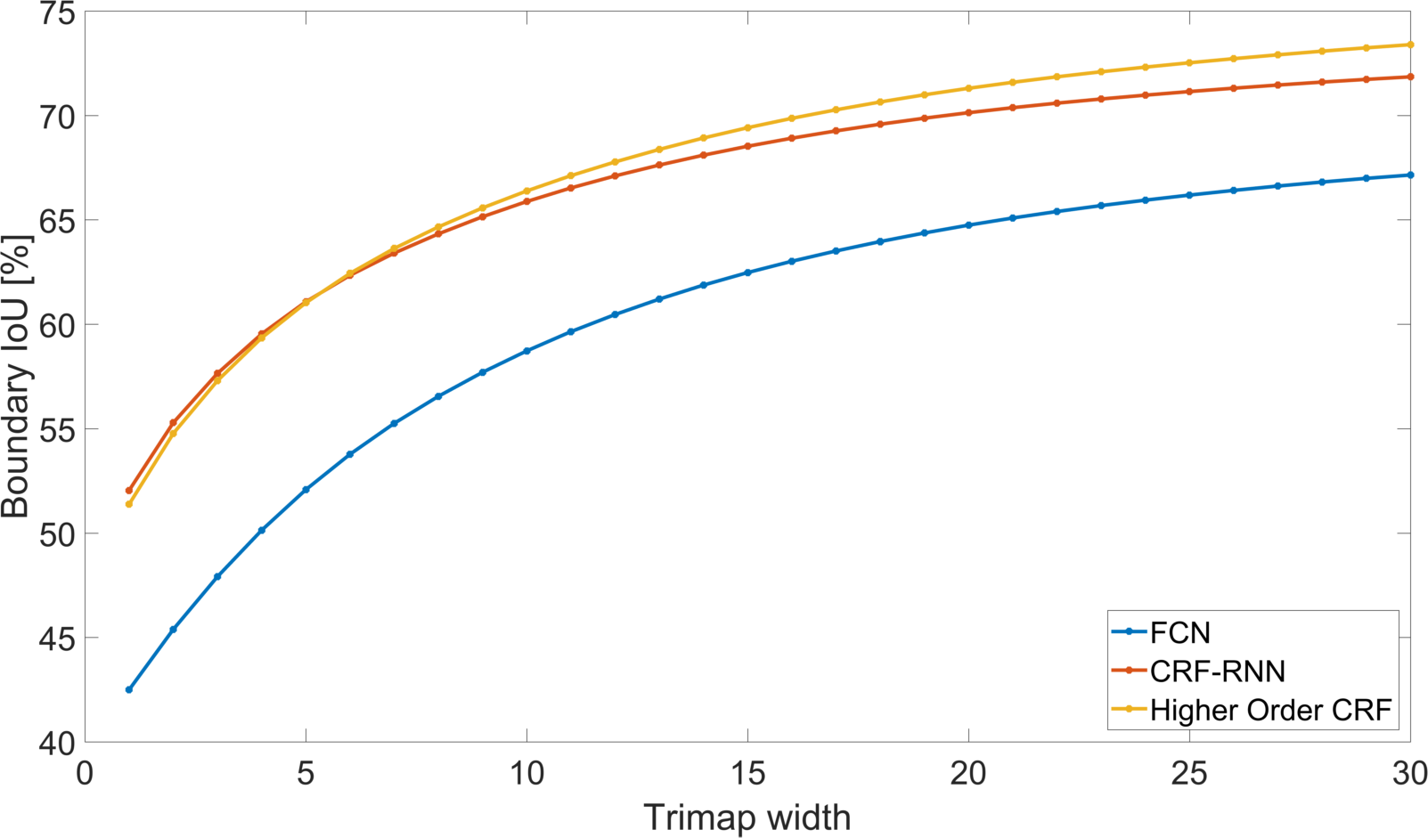
Error Analysis
Input image
Ground truth
Interior
Boundary

Slide 34
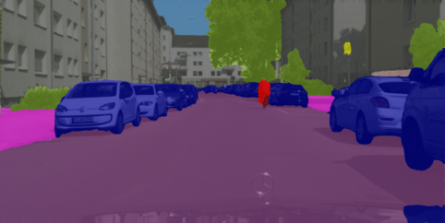
Outline
Higher Order CRFs in Deep Neural Networks (ECCV 2016)
Pixelwise Instance Segmentation with a Dynamically Instantiated Network (CVPR 2017)
Weakly and Semi-Supervised Panoptic Segmentation (ECCV 2018)

Slide 35
From Semantic to Instance Segmentation
Variable number of instances per image
Instance ids do not have any semantic meaning. Permutation invariant
No longer a straightforward mapping of images to labels.

Slide 36
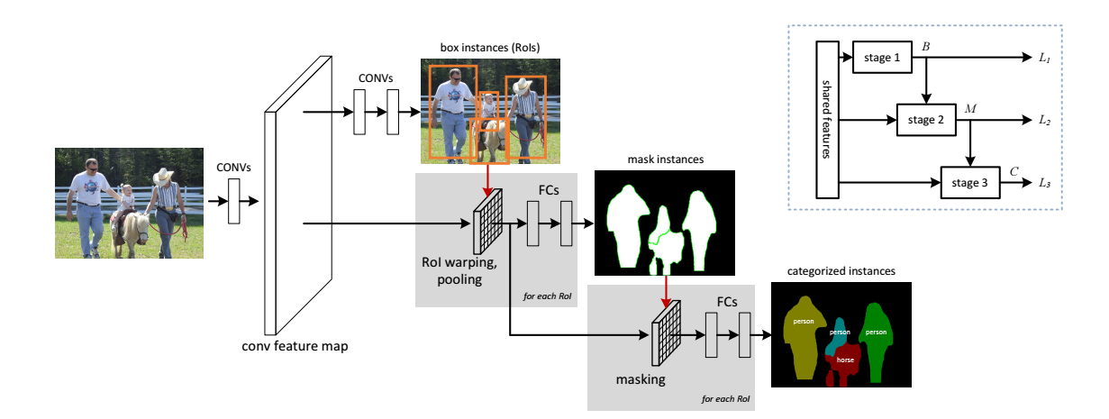
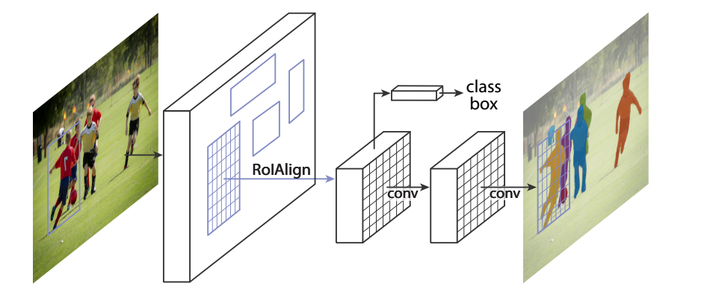
Detection based approaches
Most Instance Segmentation methods are based on Object Detection networks which are refined to produce segments instead of bounding boxes.
Multi-task Network Cascades (MNC). Dai et al. 2016
Mask R-CNN. He et al. 2017
Hariharan et al. 2014, 2015. Chen et al 2015. Dai et al. 2015. Liu et al. 2016. Li et al. 2016. Qi et al. 2017

Slide 37
Detection based approaches
Process independent object proposals
More proposals than actual objects in the image
Pixels can be ambiguous – can be assigned to multiple proposals
Limited by quality of initial proposals
Cannot segment instances outside the detected box
Detectors produce a ranked list of proposed instances and scores
Some methods cannot produce actual segmentation maps
Others require post-processing

Slide 38
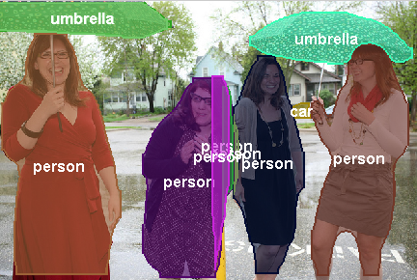
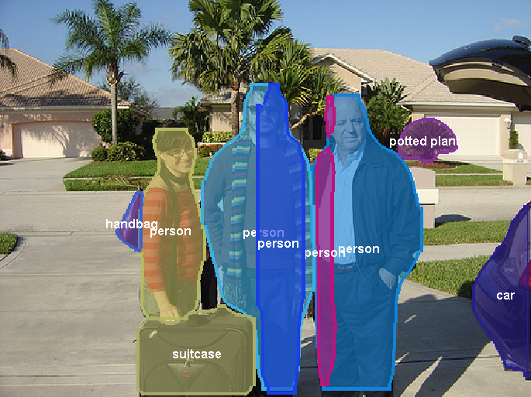
Detection based approaches
Results of FCIS [1]. Winner of 2017 COCO challenge (around the time this paper was written). Full set here
[1] Qi et al. CVPR 2017.

Slide 39
Approach
Based on a Semantic Segmentation network
Outputs a variable number of instances depending on the image
Reasons about the entire image holistically
Pixel can only belong to a single instance
Therefore has to reason about occlusions
Produces segmentation maps directly
Requires no post-processing
Segmentations are more precise

Slide 40
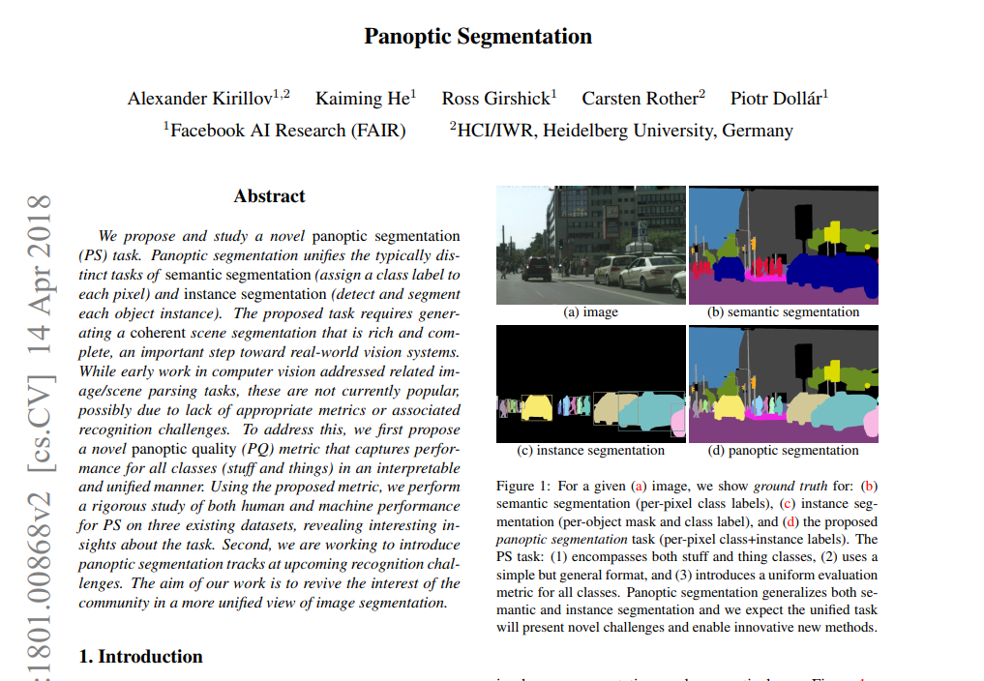
Sounds like Panoptic Segmentation?
It is, this work was before the name was coined
Panoptic segmentation
No overlapping instances
Must handle “stuff” classes

Slide 41
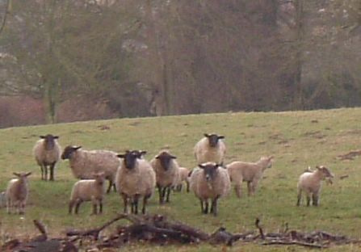
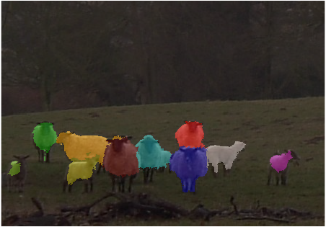
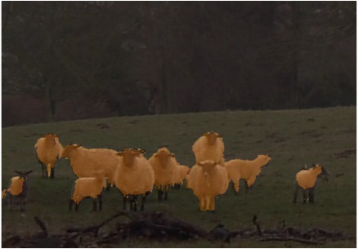
Overview
End-to-end Network
Detector
Instance Unary Potentials
Box
Pixelwise CNN
Semantic CRF
Global
Instance CRF
Shape
D+1
Input Image
Instance Segmentation
K+1
Semantic Segmentation
Semantic Segmentation subnetwork Instance Segmentation subnetwork

Slide 42
Approach
Based on initial semantic segmentation
Conditional Random Field (CRF) defined over instances.
Associates each pixel in semantic segmentation with a detection to get instance segmentation.
Three different unary potentials consider:
Object detections for the image
Make assumption that $\#Object Detections=\#Possible Instances$
Initial semantic segmentation
Object shapes
Two conceptually different models – but trained end-to-end.

Slide 43
Approach
Pairwise terms are the same Gaussian kernels as DenseCRF [1]
where D is the number of detections and changes for every image.
[1] Krahenbuhl and Koltun. NIPS 2011.

Slide 44
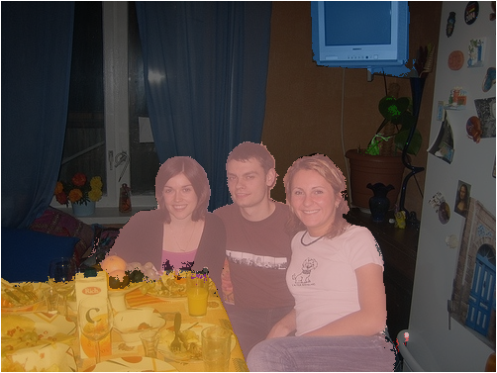
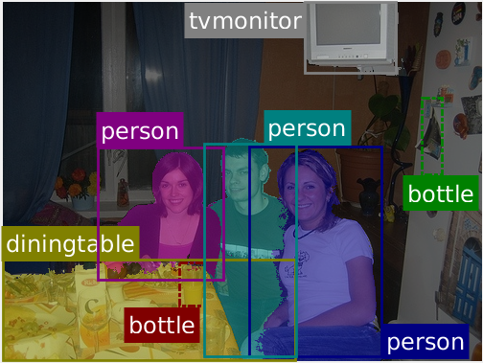
Box Term
Based on intuition that if segmented pixel lies within bounding box and has the same class, then it belongs to the instance represented by that class
Works well when we have good initial semantic segmentation

Slide 45
Box Term
- probability of $i^{th}$ pixel taking on label of $k^{th}$ detection.
- score of $k^{th}$ detection.

Slide 46
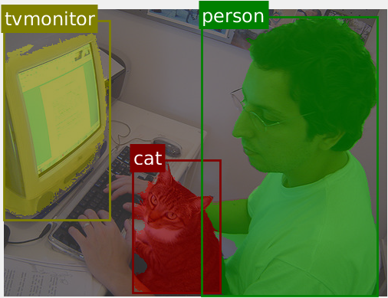
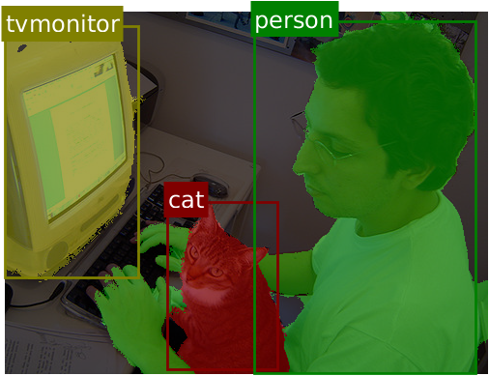
Global Term
If we have $d$ possible instances of an object class, and no further localisation information, each instances is equally probable.
Global term can handle poorly localised bounding boxes

Slide 47
Global Term
Gradients depend on entire semantic segmentation map, and are hence more stable
Semantic Segmentation performance also improves with end-to-end training

Slide 48
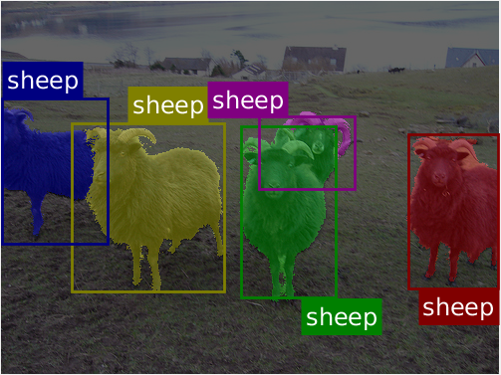
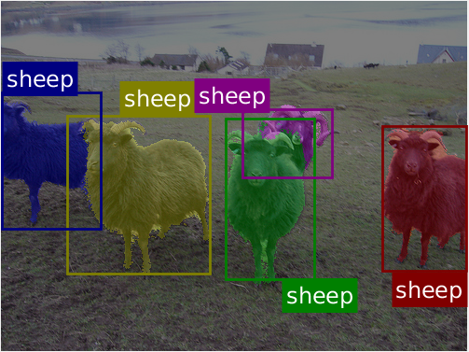
Shape Term
Intuitively, shape priors help us reason about occluded objects which look the same
Without shape priors
With shape priors

Slide 49
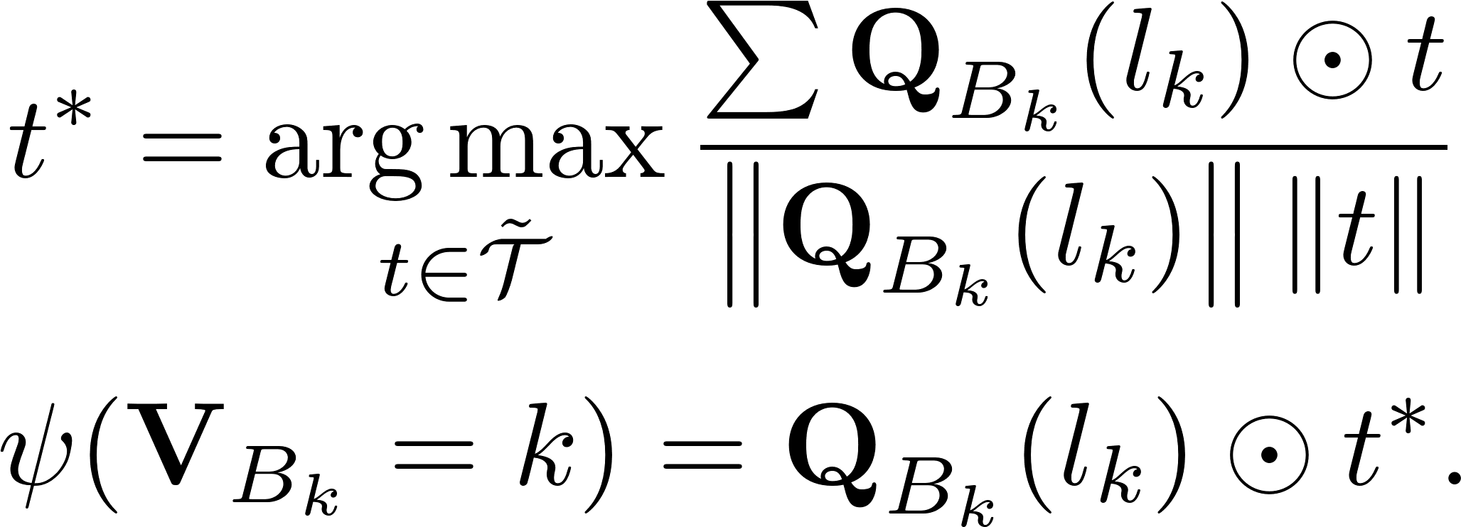
Shape Term
Match shape templates to objects
Shape templates are weights within the network
Update shape templates through backpropogation
Layer is effectively a convolution and max over channels
Initialised with old shape prior methods

Slide 50
Inference of CRF
Our predicted instance segmentation is the MAP of the CRF.
Minimise the CRF energy
Use approximate mean-field inference which can be unrolled as part of the neural network.
Enables end-to-end training

Slide 51
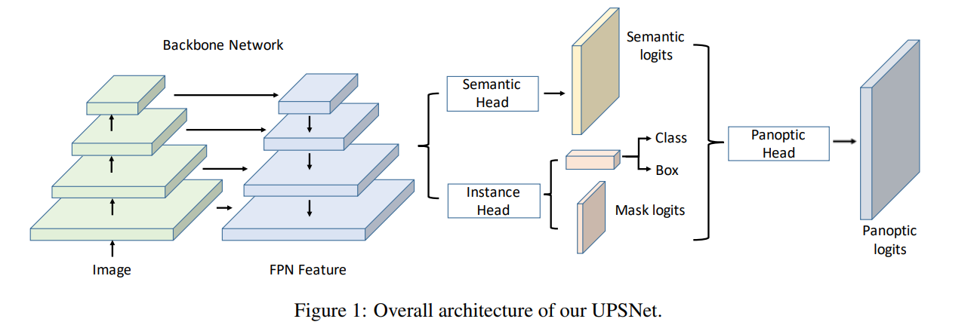
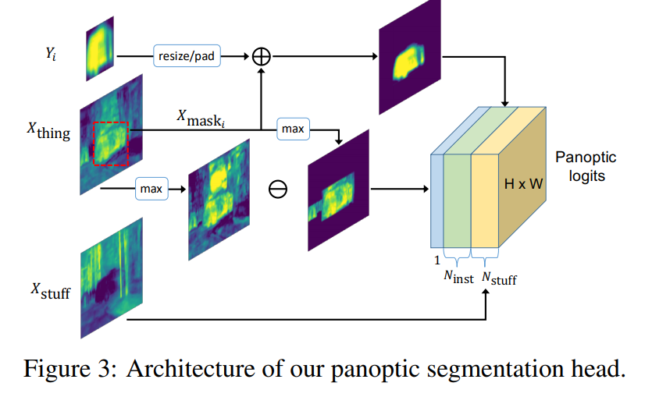
Extension
Incorporate detector into network itself and train jointly.
UPSNet a good example
Similar “Box” and “Shape” term in “Panoptic Head”
[1] Xiong et al. CVPR 2019.

Slide 52
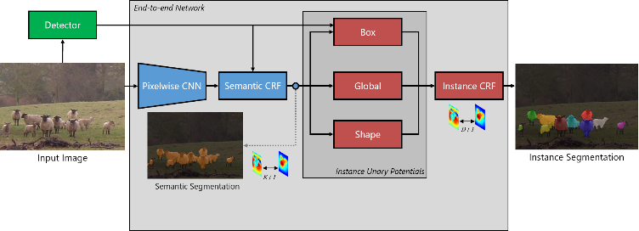
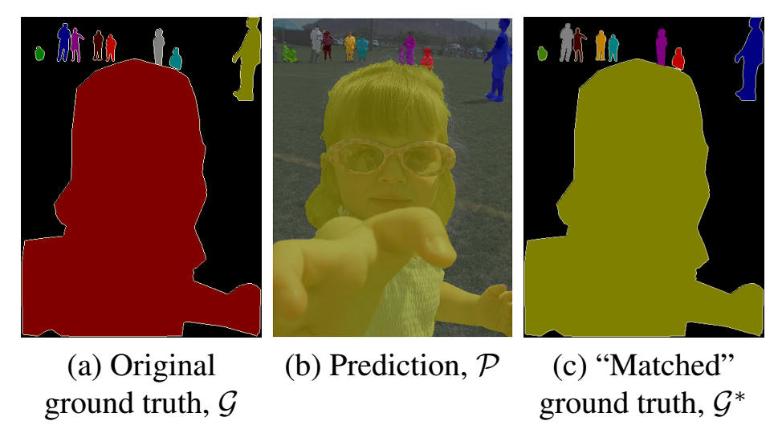
Loss Function
“Match” prediction to ground truth, since permutations of an instance labelling are actually the same result
Once matched, use any loss function. Log likelihood worked the best.

Slide 53
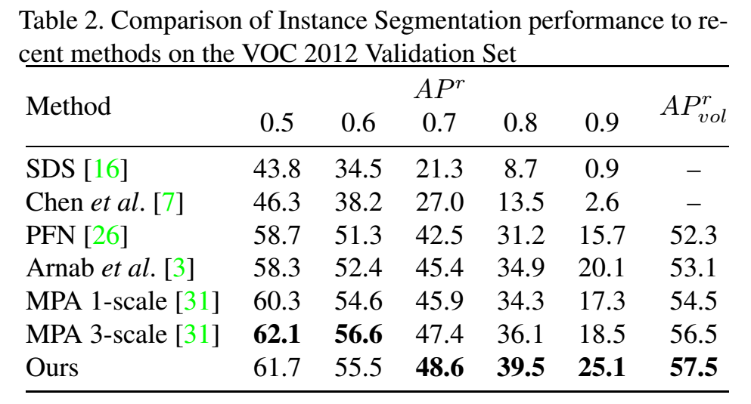
Results - VOC

Slide 54
Results - VOC

Slide 55
Results - Cityscapes

Slide 56
Results - Cityscapes

Slide 57
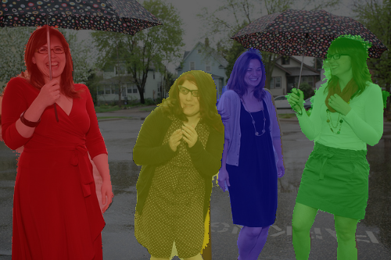
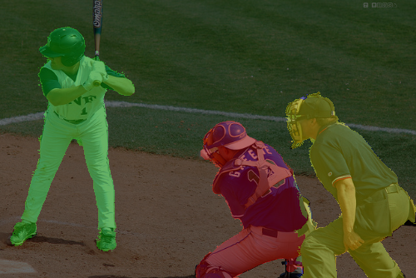
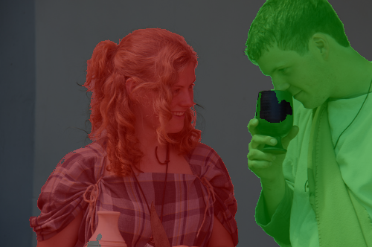
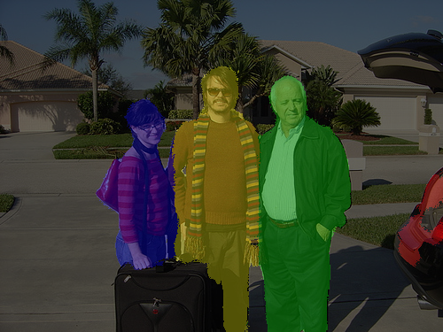
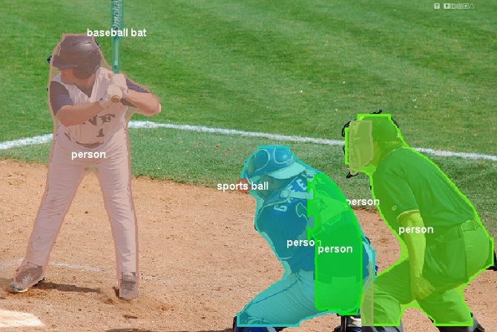
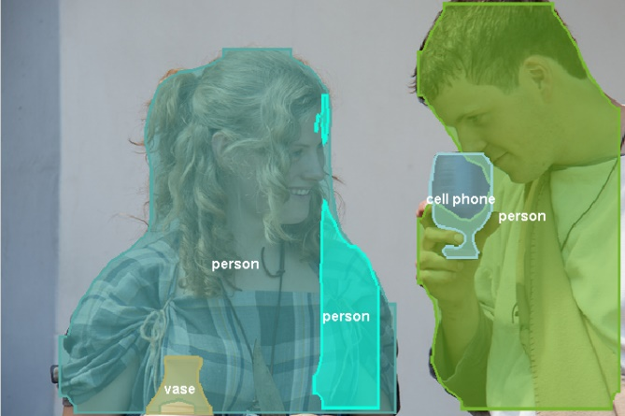
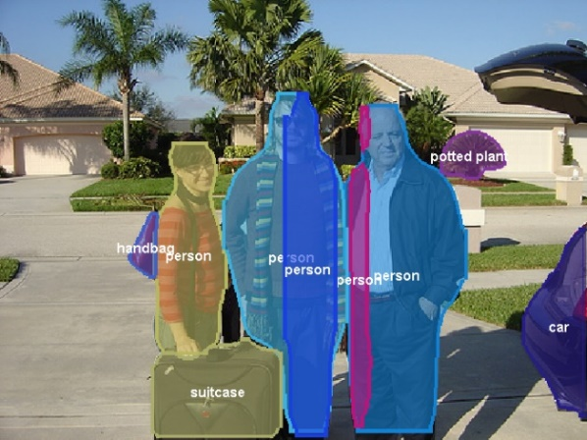
Comparison to FCIS
Ours
(VOC)
FCIS [1]
(COCO)
[1] Qi et al. CVPR 2017.

Slide 58
Outline
Higher Order CRFs in Deep Neural Networks (ECCV 2016)
Pixelwise Instance Segmentation with a Dynamically Instantiated Network (CVPR 2017)
Weakly and Semi-Supervised Panoptic Segmentation (ECCV 2018)

Slide 59
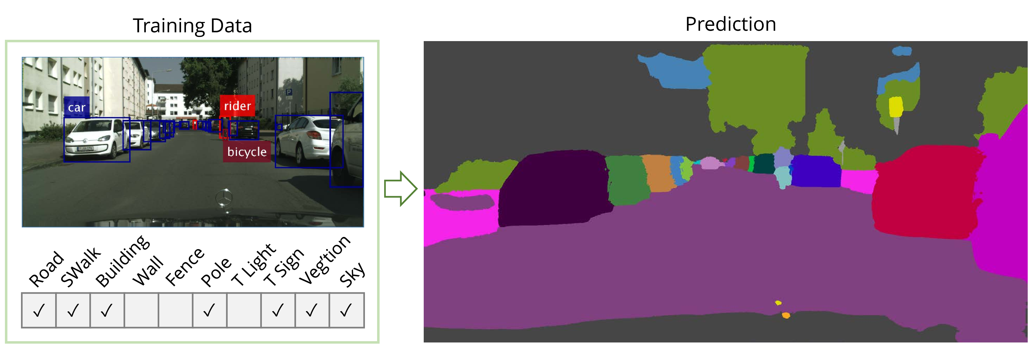
Weaker Supervision
One Cityscapes image takes 90 minutes to annotate.
Use bounding-box annotations for “things” and image-level tags for “stuff”
35x less annotation time according to [1] and [2] on Cityscapes.
[1] Papadopoulos et al. ICCV 2017. [2] Papadopoulos et al. ECCV 2014

Slide 60
Approach
Method similar to Expectation Maximisation (EM)
Alternate between
Approximate the unknown, pixel-level ground truth with the trained model.
Training the model with the approximated ground truth.
Initialisation of the approximate ground truth is critical.

Slide 61
Initialisation from Bounding Boxes
Unsupervised foreground-background segmentation algorithms provide good priors.
Perform both GrabCut [1] and MCG [2].
Estimated foreground is assigned detected class label, but only if the two methods agree. Otherwise, the pixel is marked as “ignore”
[1] Rother et al. ACM TOG 2004. [2] Arbelaez et al. CVPR 2014. [3] Khoreva et al. CVPR 2017

Slide 62
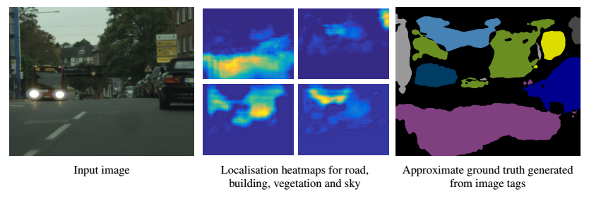
Initialisation from Image-level Tags
First train network for multilabel binary classification of tags in image.
Then perform Grad-CAM [1] to obtain pixels which contribute most to the classification.
These masks are thresholded to obtain the approximate ground truth.
road
building
vegetation
sky
[1] Selvaraju et al. ICCV 2017.

Slide 63
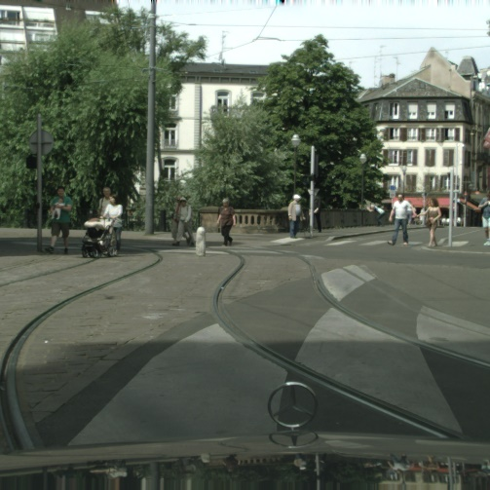
Iterative training
Cues from bounding boxes and image-level tags are combined to produce initial approximate ground truth.
Thereafter, network’s own predictions are used as the approximate ground truth.
Predictions below a confidence threshold, and not within a bounding box are marked as “ignore”.
Input image
Iteration 0
Iteration 2
Iteration 5
Ground truth

Slide 64
Iterative training
Steady improvement in network performance with more iterations of ground truth generation.

Slide 65
Results - Cityscapes

Slide 66
Results – Pascal VOC

Slide 67
Results – Pascal VOC

Slide 68
Results – Semi-Supervised
Common to mix Pascal VOC (10 000 images) and COCO (60 000 images) in training set.
Using fully- or weakly-supervised COCO data does not make much difference.
COCO data is of much lower quality than VOC.
Conclusion: Rather label a few images well (Pascal VOC) than many images poorly (COCO)
COCO annotation
VOC annotation

Slide 69
Results – Semi-Supervised
Common to mix Pascal VOC (10 000 images) and COCO (60 000 images) in training set.
Using fully- or weakly-supervised COCO data does not make much difference.
COCO data is of much lower quality than VOC.
Conclusion: Rather label a few images well (Pascal VOC) than many images poorly (COCO)
COCO annotation
VOC annotation

Slide 70
Results – Semi-Supervised
Common to mix Pascal VOC (10 000 images) and COCO (60 000 images) in training set.
Using fully- or weakly-supervised COCO data does not make much difference.
COCO data is of much lower quality than VOC.
Conclusion: Rather label a few images well (Pascal VOC) than many images poorly (COCO)
COCO annotation
VOC annotation

Slide 71
Outline
Exploiting Temporal Context for 3D Pose Estimation in the Wild (CVPR 2019) – DeepMind internship
On the Robustness of Semantic Segmentation Models to Adversarial Attacks (CVPR 2018)

Slide 72
Introduction
Monocular 3D human pose estimation is an inherently ill-posed problem
Metric ground-truth for real-world data is prohibitively difficult to collect
Common datasets are from motion capture in controlled labs
Models trained on these datasets generalise poorly to “in the wild”
Human 3.6M (mocap dataset)
“In-the-wild” data

Slide 73
Generalising to the real-world
Input
State-of-art HMR model [1]
(per-frame)
Significant failure
Ambiguity
[1] Kanazawa et al. End-to-end recovery of human shape and pose. CVPR 2018.

Slide 74
Temporal Consistency
Temporal dimension of ordinary video encodes valuable information
Multiple views of person observed
Body shape and bone lengths remain constant
Joint positions in both 2D and 3D vary slowly

Slide 75
Our approach
Propose a form of bundle adjustment
Take into account temporal information and multi-view geometry of the video
Apply our method to about 107 000 YouTube videos in the Kinetics dataset.
Automatically create a new “in-the-wild” dataset from this
Improve performance of per-frame model using this dataset.

Slide 76
Bundle Adjustment
Objective function consists of reprojection, temporal and prior terms

Slide 77
Bundle Adjustment
Objective function consists of reprojection, temporal and prior terms
Use the SMPL body model [1] to parameterise the 3D pose
Pose parameters:
Shape parameters:
Shape remains constant throughout the video.
Pose variation
Shape variation
[1] Loper et al. SMPL: A Skinned Multi-Person Linear Model. ECCV 2016.

Slide 78
Bundle Adjustment
Objective function consists of reprojection, temporal and prior terms
Use the SMPL body model [1] to parameterise the 3D pose
3D joints (and mesh vertices) are obtained from the differentiable SMPL function
3D joints, .
Assume scaled orthographic projection, , with camera parameters .
We can project this onto 2D using the camera parameters.
2D joints, .

Slide 79
Reprojection Error
Encourage 3D joint to project onto predicted 2D keypoints.
We use 2D human detector of [1].
Use robust Huber error function
And weight each reprojection term by the keypoint detector’s confidence.
Input keypoints
Predicted joint projection
Predicted 3D mesh
[1] Papanderou et al. Towards accurate multi-person pose in the wild. CVPR 2017.

Slide 80
Temporal Error
Encourage smooth motion of predicted:
3D joints,
2D joint projection,
camera parameters,

Slide 81
3D Prior
Many 3D poses (some not humanly possible) that project correctly onto 2D and temporally smooth.
One term encourages solution to stay close to the initialisation, the other the commonly used GMM pose prior [1].
No prior
Prior
[1] Bogo et al. Keep it SMPL … ECCV 2016.

Slide 82
3D Prior
Many 3D poses (some not humanly possible) that project correctly onto 2D and temporally smooth.
One term encourages solution to stay close to the initialisation, the other the commonly used GMM pose prior [1].
[1] Bogo et al. Keep it SMPL … ECCV 2016.

Slide 83
Bundle Adjustment
Objective function consists of reprojection, temporal and prior terms
Use the per-frame results of HMR [1] to initialise.
Optimise with L-BFGS
Only optimising SMPL- and camera-parameters
$10+75F$ parameters where $F$ is the number of frames in the video
[1] Kanazawa et al. End-to-end recovery of human shape and pose. CVPR 2018.

Slide 84
Scaling up to Kinetics
Data very noisy.
Initialisation from HMR and 2D pose detector often incorrect.
Also need to deal with multiple people
Tracking person-of-interest not robust to detection failures.
Modify reprojection loss instead

Slide 85
Scaling up to Kinetics
Data very noisy.
Initialisation from HMR and 2D pose detector often incorrect.
Also need to deal with multiple people
Modify reprojection loss instead
“Inner min” means the loss is with respect to the best matching 2D pose estimate
“Outer min” means that if our estimate is too far from 2D pose, we consider it an outlier and pay a constant penalty.

Slide 86
Exploiting temporal consistency
Input
State-of-art HMR model [1]
(per-frame)
Bundle adjustment
[1] Kanazawa et al. End-to-end recovery of human shape and pose. CVPR 2018.

Slide 87
Exploiting temporal consistency
[1] Kanazawa et al. End-to-end recovery of human shape and pose. CVPR 2018.

Slide 88
Ablation study on Human 3.6M
Mocap dataset, has metric 3D ground truth
Allows us to set hyperparameters.
Each term in objective improves result.
Ground truth keypoints provide substantial benefits
Occluded keypoints help a lot

Slide 89
Comparison on Human 3.6M
Compare to other methods using the SMPL model
Our whole-video approach also achieves state-of-the-art performance on Human 3.6M

Slide 90
Scaling up to Kinetics
Run our method on 106 589 YouTube videos in the Kinetics dataset.
Thresholding the normalised loss, we obtain 16 720 videos containing 4.1 million frames.
We keep the frames where our 2D projections match that of our 2D keypoint detector.
Final dataset is 3.4 million frames.
Available to public: https://github.com/deepmind/Temporal-3D-Pose-Kinetics
Example of video automatically filtered out

Slide 91
Scaling up to Kinetics
Auto-generated dataset contains diversity in pose, scene, action and camera viewpoints not found in mocap.
HMR (per-frame model)
Ours

Slide 92
Effect of our new dataset
Training with our new automatically-generated dataset improves the performance of HMR on two datasets.
3DPW – “in-the-wild”
HumanEVA – mocap
More improvement from 3.4 million additional frames, than 300 000 frames.
PA-MPJPE error (mm) on 3DPW and HumanEVA datasets
[1] Kanazawa et al. End-to-end recovery of human shape and pose. CVPR 2018.

Slide 93
Conclusion
Interpret mean-field inference of generic CRFs as a recurrent network
Enables end-to-end training of CNN and CRF models
Applications in structured prediction problems like semantic- and instance/panoptic-segmentation
We can effectively labelled weakly labelled data as supervision for complex tasks.
Weakly supervised panoptic segmentation
Up to 95% of fully-supervised performance, with annotation time reduced by as much as 35x.
If you have annotation budget, better to label a few images well rather than many images poorly.
3D human pose estimation
Can leverage temporal consistency and unlabelled YouTube videos to improve existing models

Slide 94
Collaborators
Sadeep Jayasumana
Shuai Zheng
Qizhu Li
Philip Torr
Carl Doersch
Andrew Zisserman

Slide 95
Questions?
A Arnab, S Jayasumana, S Zheng, P Torr. Higher Order Conditional Random Fields in Deep Neural Networks. ECCV, 2016
A Arnab and P Torr. Pixelwise Instance Segmentation with a Dynamically Instantiated Network. CVPR, 2017
A Arnab, O Miksik, P Torr. On the Robustness of Semantic Segmentation Models to Adversarial Attacks. CVPR, 2018
Q Li*, A Arnab*, P Torr. Weakly- and Semi-Supervised Panoptic Segmentation. ECCV, 2018
A Arnab*, C Doersch*, A Zisserman. Exploiting Temporal Context for 3D Human Pose Estimation in the Wild. CVPR, 2019.

