Slide 1
Exploiting Temporal Context for 3D Pose Estimation in the Wild
Anurag Arnab

Slide 2
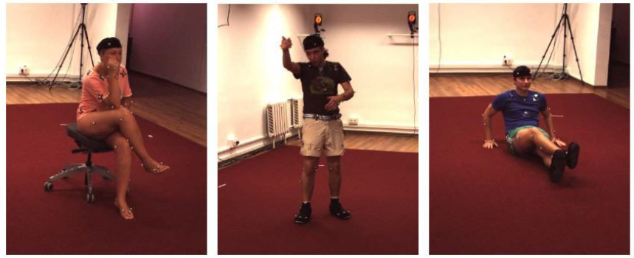
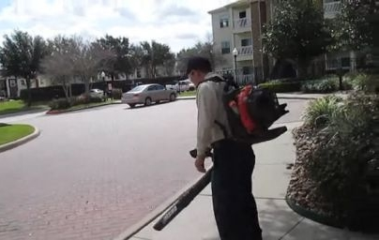
Introduction
Monocular 3D human pose estimation is an inherently ill-posed problem
Metric ground-truth for real-world data is prohibitively difficult to collect
Common datasets are from motion capture in controlled labs
Models trained on these datasets generalise poorly to “in the wild”
Human 3.6M (mocap dataset)
“In-the-wild” data

Slide 3
Generalising to the real-world
Input
State-of-art HMR model [1]
(per-frame)
Significant failure
Ambiguity
[1] Kanazawa et al. End-to-end recovery of human shape and pose. CVPR 2018.

Slide 4
Temporal Consistency
Temporal dimension of ordinary video encodes valuable information
Multiple views of person observed
Body shape and bone lengths remain constant
Joint positions in both 2D and 3D vary slowly

Slide 5
Our approach
Propose a form of bundle adjustment
Take into account temporal information and multi-view geometry of the video
Apply our method to about 107 000 YouTube videos in the Kinetics dataset.
Automatically create a new “in-the-wild” dataset from this
Improve performance of per-frame model using this dataset.

Slide 6
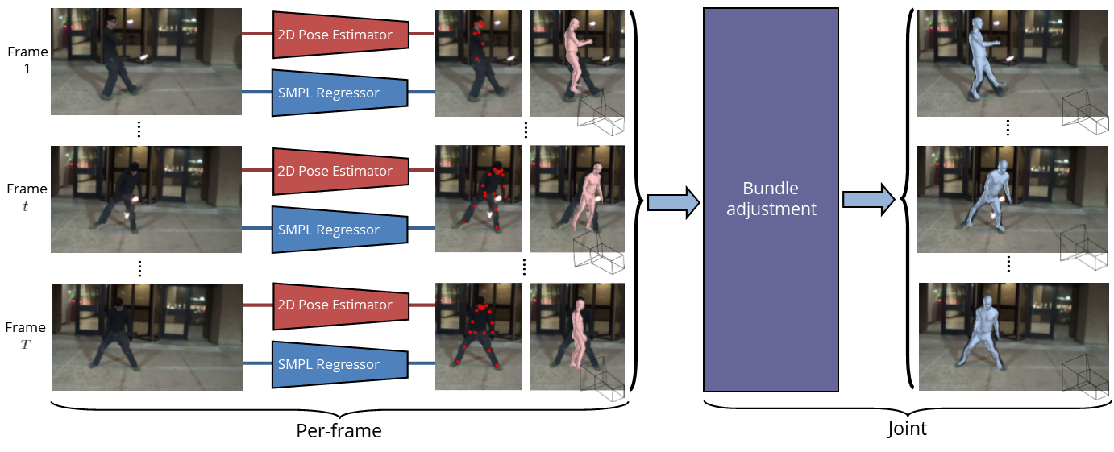
Bundle Adjustment
Objective function consists of reprojection, temporal and prior terms

Slide 7
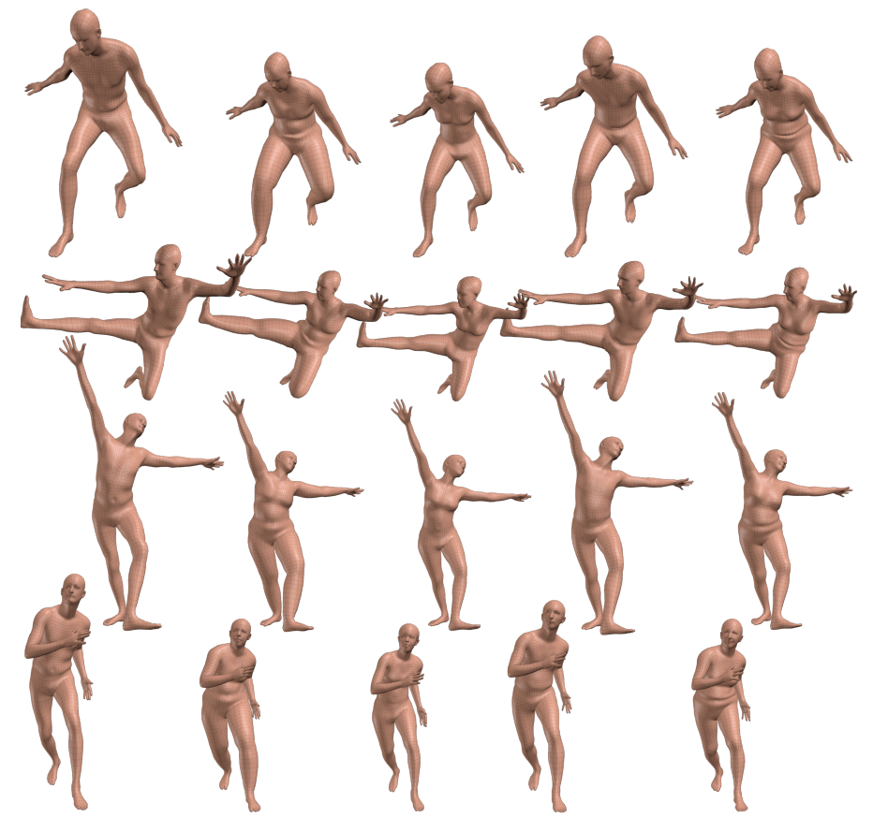
Bundle Adjustment
Objective function consists of reprojection, temporal and prior terms
Use the SMPL body model [1] to parameterise the 3D pose
Pose parameters:
Shape parameters:
Shape remains constant throughout the video.
Pose variation
Shape variation
[1] Loper et al. SMPL: A Skinned Multi-Person Linear Model. ECCV 2016.

Slide 8
Bundle Adjustment
Objective function consists of reprojection, temporal and prior terms
Use the SMPL body model [1] to parameterise the 3D pose
3D joints (and mesh vertices) are obtained from the differentiable SMPL function
3D joints, .
Assume scaled orthographic projection, , with camera parameters .
We can project this onto 2D using the camera parameters.
2D joints, .

Slide 9
Reprojection Error
Encourage 3D joint to project onto predicted 2D keypoints.
We use 2D human detector of [1].
Use robust Huber error function
And weight each reprojection term by the keypoint detector’s confidence.
Input keypoints
Predicted joint projection
Predicted 3D mesh
[1] Papanderou et al. Towards accurate multi-person pose in the wild. CVPR 2017.

Slide 10
Temporal Error
Encourage smooth motion of predicted:
3D joints,
2D joint projection,
camera parameters,

Slide 11
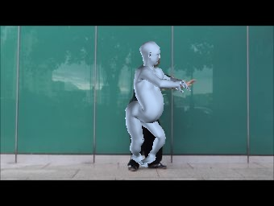
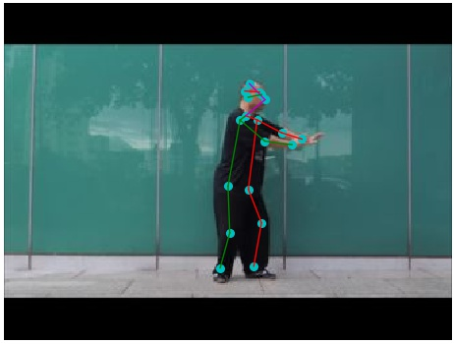
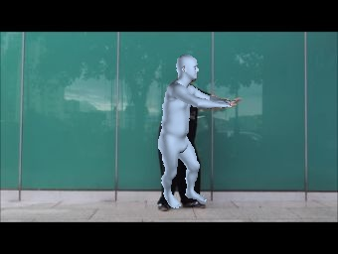
3D Prior
Many 3D poses (some not humanly possible) that project correctly onto 2D and temporally smooth.
One term encourages solution to stay close to the initialisation, the other the commonly used GMM pose prior [1].
No prior
Prior
[1] Bogo et al. Keep it SMPL … ECCV 2016.

Slide 12
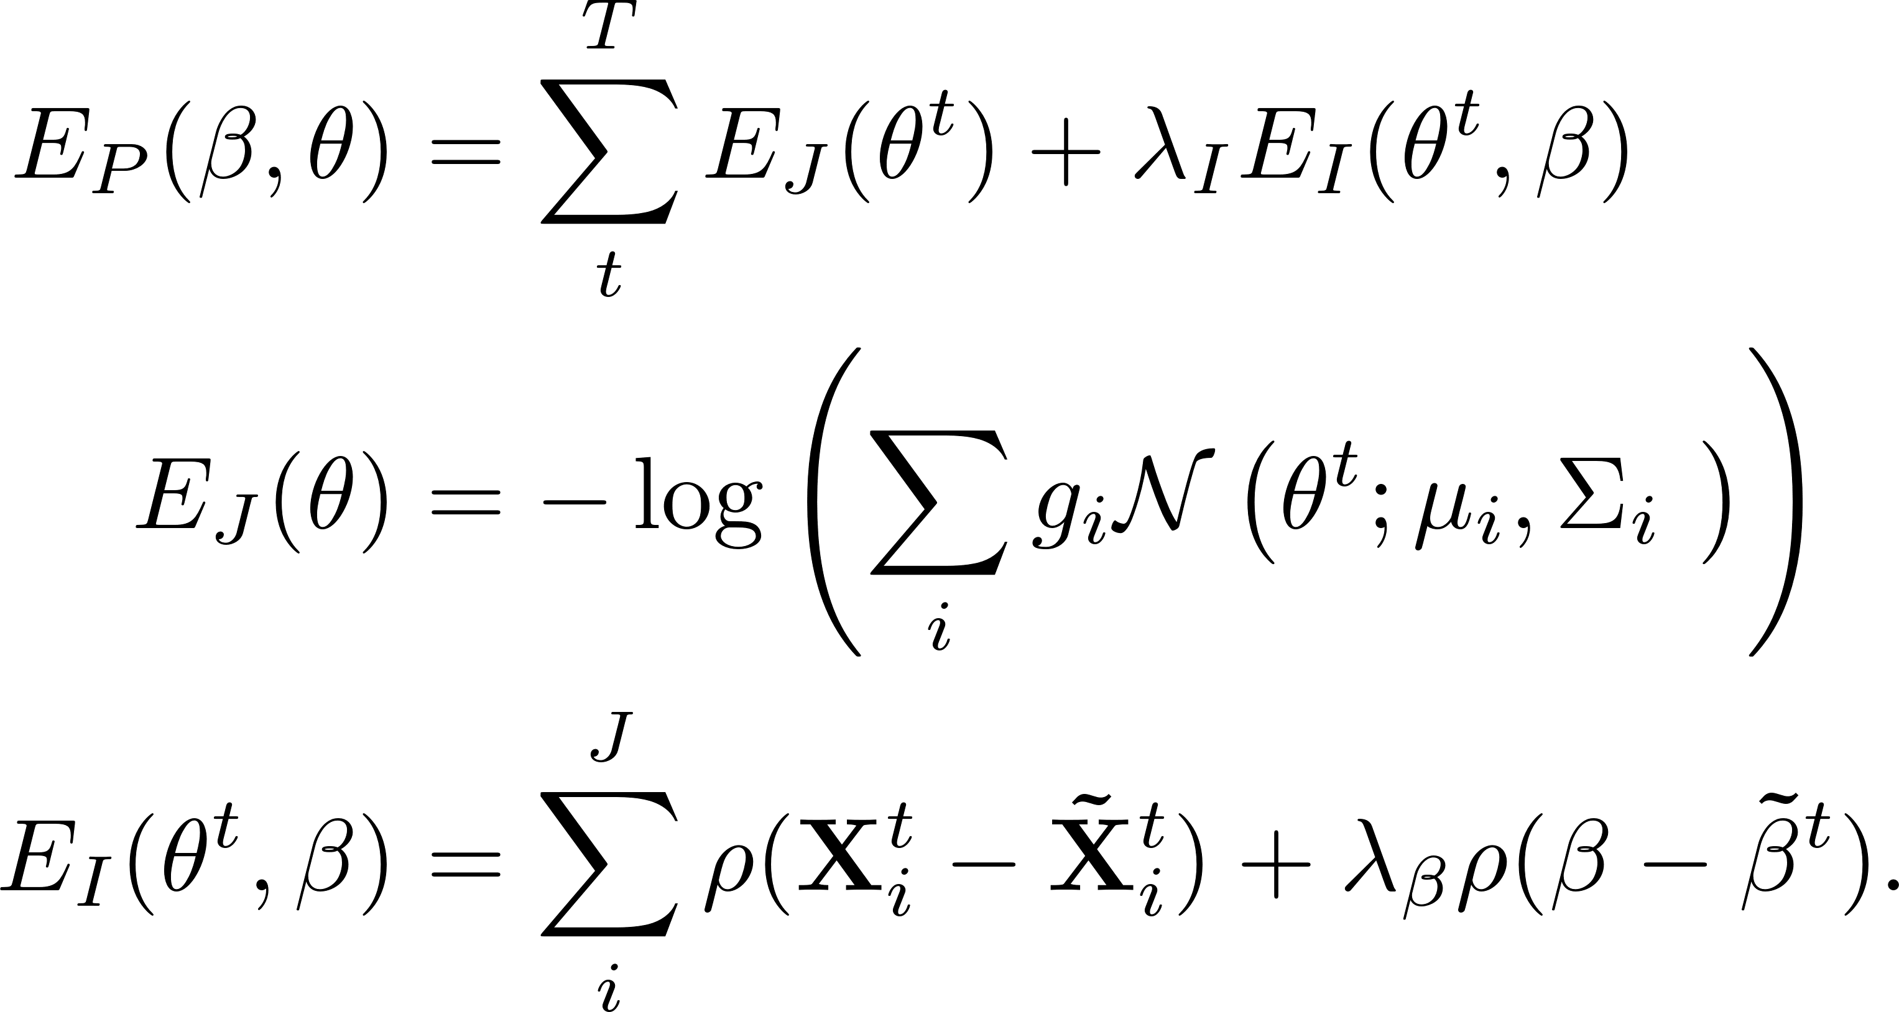
3D Prior
Many 3D poses (some not humanly possible) that project correctly onto 2D and temporally smooth.
One term encourages solution to stay close to the initialisation, the other the commonly used GMM pose prior [1].
[1] Bogo et al. Keep it SMPL … ECCV 2016.

Slide 13
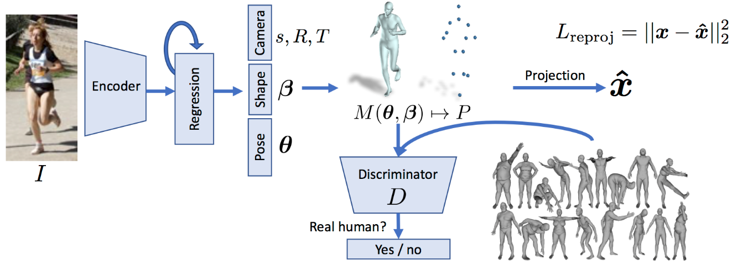
Bundle Adjustment
Objective function consists of reprojection, temporal and prior terms
Use the per-frame results of HMR [1] to initialise.
Optimise with L-BFGS
Only optimising SMPL- and camera-parameters
$10+75F$ parameters where $F$ is the number of frames in the video
[1] Kanazawa et al. End-to-end recovery of human shape and pose. CVPR 2018.

Slide 14
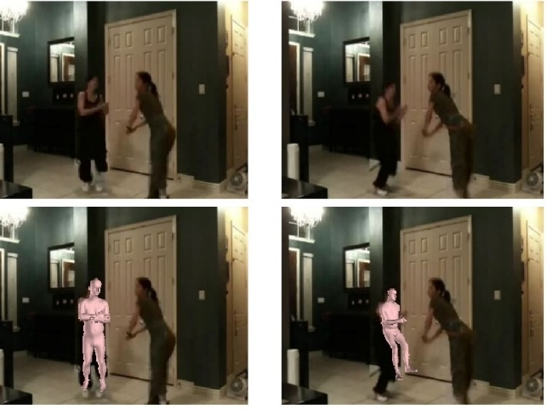
Scaling up to Kinetics
Data very noisy.
Initialisation from HMR and 2D pose detector often incorrect.
Also need to deal with multiple people
Tracking person-of-interest not robust to detection failures.
Modify reprojection loss instead

Slide 15
Scaling up to Kinetics
Data very noisy.
Initialisation from HMR and 2D pose detector often incorrect.
Also need to deal with multiple people
Modify reprojection loss instead
“Inner min” means the loss is with respect to the best matching 2D pose estimate
“Outer min” means that if our estimate is too far from 2D pose, we consider it an outlier and pay a constant penalty.

Slide 16
Exploiting temporal consistency
Input
State-of-art HMR model [1]
(per-frame)
Bundle adjustment
[1] Kanazawa et al. End-to-end recovery of human shape and pose. CVPR 2018.

Slide 17
Exploiting temporal consistency
[1] Kanazawa et al. End-to-end recovery of human shape and pose. CVPR 2018.

Slide 18
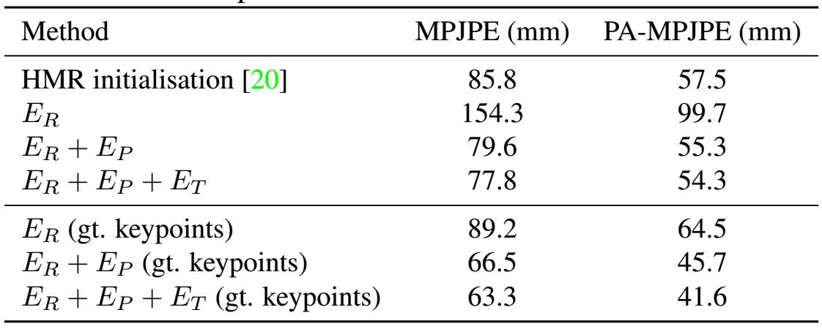
Ablation study on Human 3.6M
Mocap dataset, has metric 3D ground truth
Allows us to set hyperparameters.
Each term in objective improves result.
Ground truth keypoints provide substantial benefits
Occluded keypoints help a lot

Slide 19
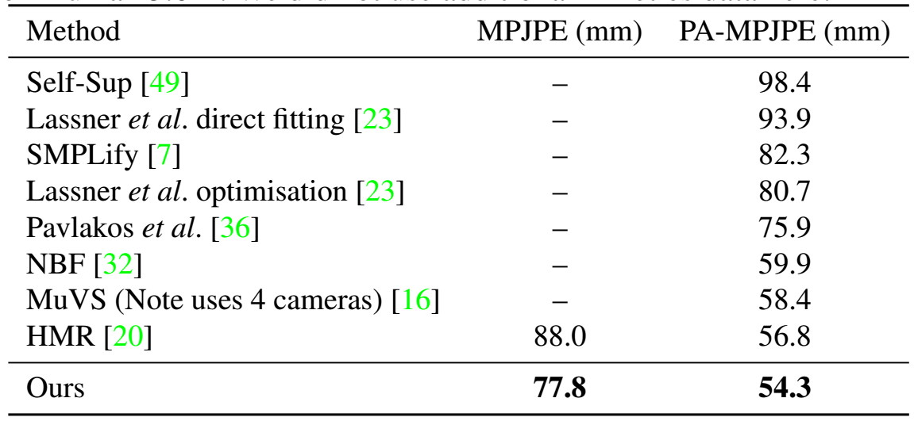
Comparison on Human 3.6M
Compare to other methods using the SMPL model
Our whole-video approach also achieves state-of-the-art performance on Human 3.6M

Slide 20
Scaling up to Kinetics
Run our method on 106 589 YouTube videos in the Kinetics dataset.
Thresholding the normalised loss, we obtain 16 720 videos containing 4.1 million frames.
We keep the frames where our 2D projections match that of our 2D keypoint detector.
Final dataset is 3.4 million frames.
Available to public: https://github.com/deepmind/Temporal-3D-Pose-Kinetics
Example of video automatically filtered out

Slide 21
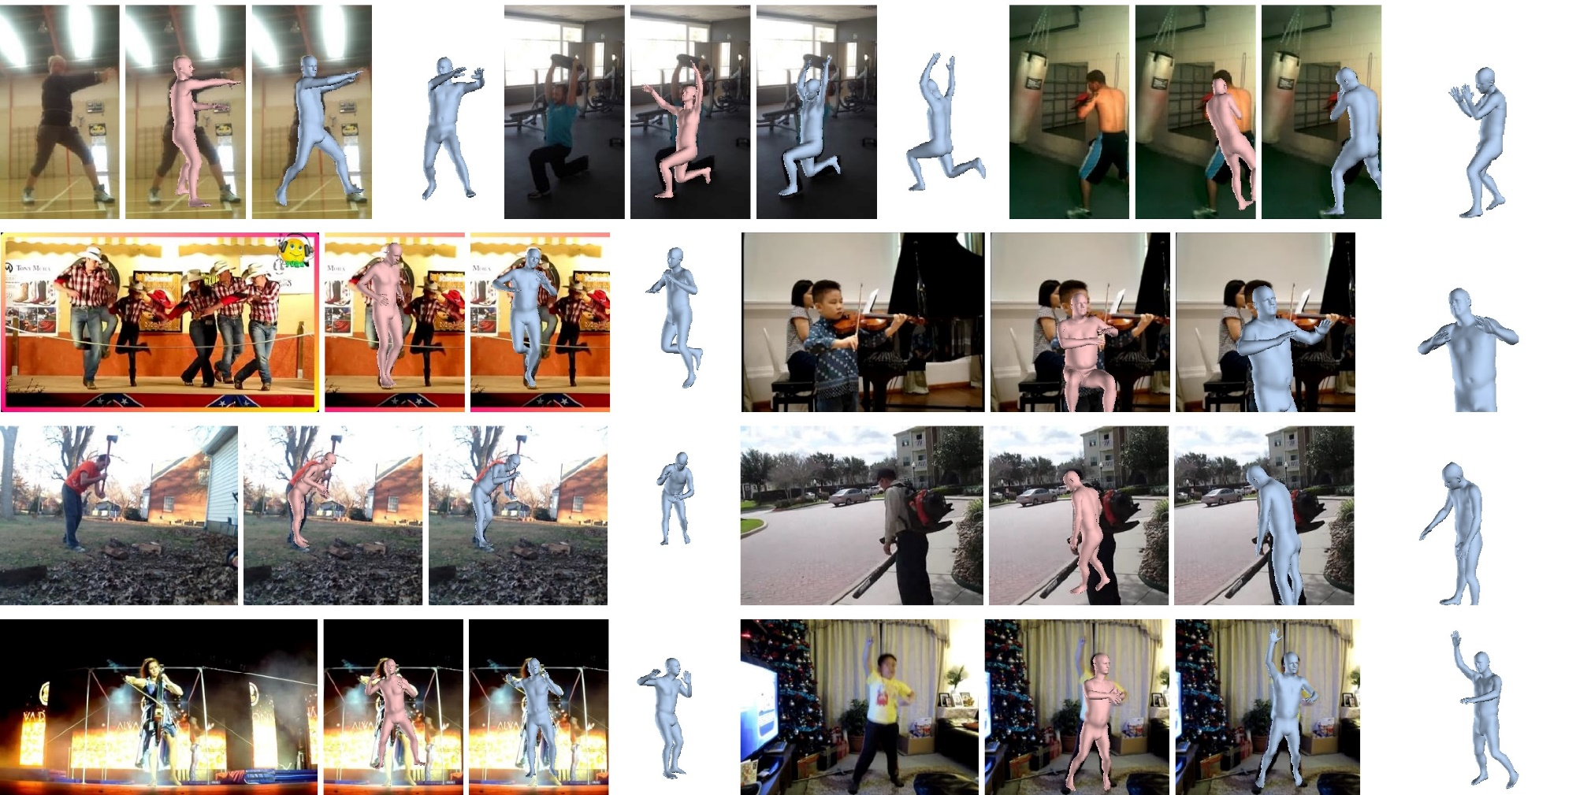
Scaling up to Kinetics
Auto-generated dataset contains diversity in pose, scene, action and camera viewpoints not found in mocap.
HMR (per-frame model)
Ours

Slide 22
Effect of our new dataset
Training with our new automatically-generated dataset improves the performance of HMR on two datasets.
3DPW – “in-the-wild”
HumanEVA – mocap
More improvement from 3.4 million additional frames, than 300 000 frames.
PA-MPJPE error (mm) on 3DPW and HumanEVA datasets
[1] Kanazawa et al. End-to-end recovery of human shape and pose. CVPR 2018.

Slide 23
Conclusion
We can effectively labelled weakly labelled data as supervision for complex tasks.
Weakly supervised panoptic segmentation
Up to 95% of fully-supervised performance, with annotation time reduced by as much as 35x.
If you have annotation budget, better to label a few images well rather than many images poorly.
3D human pose estimation
Can leverage temporal consistency and unlabelled YouTube videos to improve existing models

Slide 24
Questions?
A Arnab*, C Doersch*, A Zisserman. Exploiting Temporal Context for 3D Human Pose Estimation in the Wild. CVPR, 2019.
Auto-generated dataset here: https://github.com/deepmind/Temporal-3D-Pose-Kinetics
Poster #92, Tuesday 18 June, 15:20 to 18:00

